Slide 1
How are embryonic stem cells are stimulated to differentiate?
As long as the embryonic stem cells in culture are grown under certain conditions, they can remain undifferentiated (unspecialized). But if cells are allowed to clump together to form embryoid bodies, they begin to differentiate spontaneously.
Although spontaneous differentiation is a good indication that a culture of embryonic stem cells is healthy, it is not an efficient way to produce cultures of specific cell types.

Slide 2
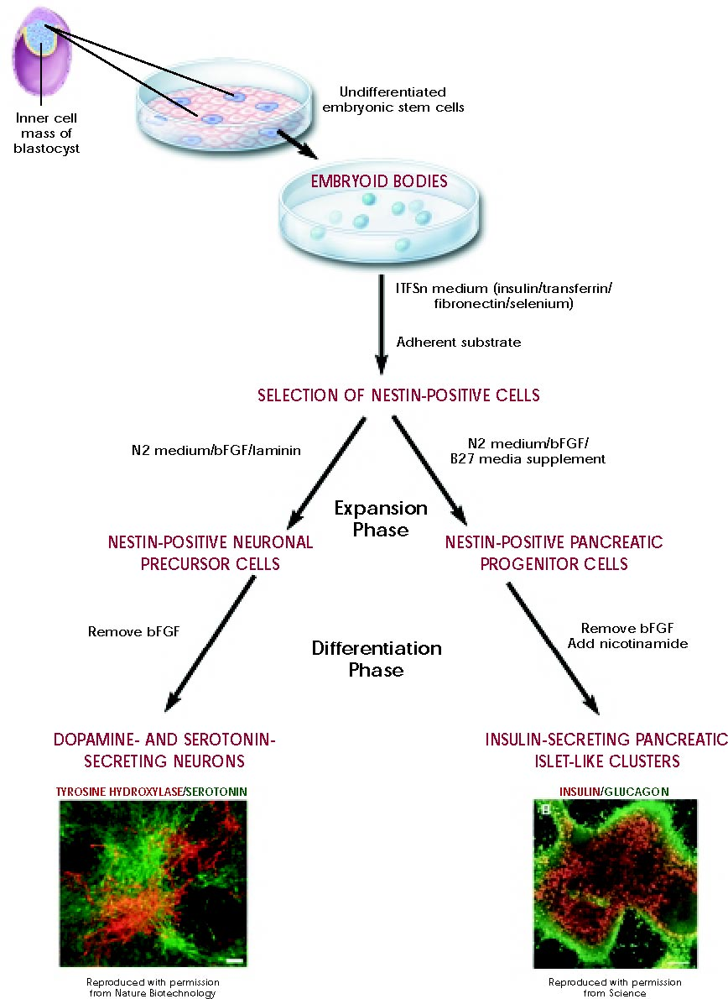
Dr. Ziad W Jaradat ©

Slide 3
To generate cultures of specific types of differentiated cells—heart muscle cells, blood cells, or nerve cells, for example—scientists try to control differentiation of embryonic stem cells by;
  Change the chemical composition of the culture medium
  Alter the surface of the culture dish
  Modify the cells by inserting specific genes or adding specific grwoth factors.
If scientists can reliably direct the differentiation of embryonic stem cells into specific cell types, they may be able to use the resulting, differentiated cells to treat certain diseases at some point in the future.

Slide 4
Diseases that might be treated by transplanting cells generated from human embryonic stem cells include Parkinson's disease, diabetes, traumatic spinal cord injury, Purkinje cell degeneration, Duchenne's muscular dystrophy, heart disease, and vision and hearing loss.

Slide 5
What are the similarities and differences between embryonic and adult stem cells?
Adult and embryonic stem cells differ in the number
and type of differentiated cells types they can become.
Embryonic stem cells can become all cell types of the
body because they are pluripotent.
Adult stem cells are generally limited to differentiating
into different cell types of their tissue of origin. However,
some evidence suggests that adult stem cell plasticity
may exist, increasing the number of cell types a given
adult stem cell can become.

Slide 6
Large numbers of embryonic stem cells can be relatively easily grown in culture, while adult stem cells are rare in mature tissues and methods for expanding their numbers in cell culture have not yet been worked out. This is an important distinction, as large numbers of cells are needed for stem cell replacement therapies.
A potential advantage of using stem cells from an adult is that the patient's own cells could be expanded in culture and then reintroduced into the patient. The use of the patient's own adult stem cells would mean that the cells would not be rejected by the immune system.
Embryonic stem cells from a donor introduced into a patient could cause transplant rejection.

Slide 7
What are the potential uses of human stem cells?
What are the obstacles that must be overcome before these potential uses will be realized?
There are many ways in which human stem cells can be used in basic research and in clinical research. However, there are many technical hurdles between the promise of stem cells and the realization of these uses, which will only be overcome by continued intensive stem cell research.

Slide 8
Potential uses
Studies of human embryonic stem cells may yield information about the complex events that occur during human development. A primary goal of this work is to identify how undifferentiated stem cells become differentiated. Scientists know that turning genes on and off is central to this process. Some of the most serious medical conditions, such as cancer and birth defects, are due to abnormal cell division and differentiation.
A better understanding of the genetic and molecular controls of these processes may yield information about how such diseases arise and suggest new strategies for therapy.

Slide 9
Human stem cells could also be used to test new drugs. For example, new medications could be tested for safety on differentiated cells generated from human pluripotent cell lines.
Other kinds of cell lines are already used in this way. Cancer cell lines, for example, are used to screen potential anti-tumor drugs. But, the availability of pluripotent stem cells would allow drug testing in a wider range of cell types.

Slide 10
Perhaps the most important potential application of human stem cells is the generation of cells and tissues that could be used for cell-based therapies.
Today, donated organs and tissues are often used to replace ailing (ill) or destroyed tissue, but the need for transplantable tissues and organs far outweighs the available supply.
Stem cells, directed to differentiate into specific cell types, offer the possibility of a renewable source of replacement cells and tissues to treat diseases including Parkinson's and Alzheimer's diseases, spinal cord injury, stroke, burns, heart disease, diabetes, osteoarthritis, and rheumatoid arthritis.

Slide 11
For example, it may become possible to generate healthy heart muscle cells in the laboratory and then transplant those cells into patients with chronic heart disease.
Preliminary research in mice and other animals indicates that bone marrow stem cells, transplanted into a damaged heart, can generate heart muscle cells and successfully repopulate the heart tissue. Other recent studies in cell culture systems indicate that it may be possible to direct the differentiation of embryonic stem cells or adult bone marrow cells into heart muscle cells (Figure 4).

Slide 12
In people who suffer from type I diabetes, the cells of the pancreas that normally produce insulin are destroyed by the patient's own immune system. New studies indicate that it may be possible to direct the differentiation of human embryonic stem cells in cell culture to form insulin-producing cells that eventually could be used in transplantation therapy for diabetics.

Slide 13
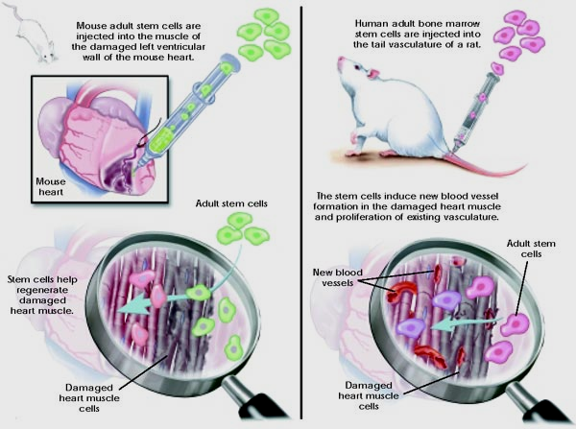
Figure 4.
Heart muscle repair with adult stem cells.

Slide 14
Also, to avoid the problem of immune rejection, scientists are experimenting with different research strategies to generate tissues that will not be rejected.

Slide 15
Regenerative medicine
“Regenerative medicine” describes a set of innovative approaches to the treatment of illness, injury, and disability, focusing on the growth, replacement, and repair of cells, organs, and tissues specific to the health needs of particular individuals. The extraordinary breadth of application of this approach is clear from an enumeration of just a few areas of regenerative medicine research, such as stem cells, including embryonic stem cells, pluripotent stem cells produced by genetic reprogramming, and multipotent stem cells from non-embryonic tissues; techniques for stimulating endogenous cell growth and repair for the kidney and pancreas in diabetes, or for digits and limbs injured as a result of trauma; and the growth of replacement tissues and organs, for example, blood vessels, hollow organs like the bladder, and even solid organs like the heart

Slide 16
Ethics of using embryonic stem cells
The ethical challenges regarding human embryonic stem cell (hESC) research, emphasizing that ethical dilemma involving the destruction of a human embryo is a major factor that may have limited the development of hESC-based clinical therapies. With previous derivation of induced pluripotent stem cells (iPSCs) this problem has been overcome, however current perspectives regarding clinical translation of iPSCs still remain. Unlimited differentiation potential of iPSCs which can be used in human reproductive cloning, as a risk for generation of genetically engineered human embryos and human-animal chimeras, is major ethical issue, while undesired differentiation and malignant transformation are major safety

